Slide 1


PAYMENT
PAYMENT
TABLE OF CONTENTS
FRAUD TRANSACTIONS
FRAUD DETECTION
GENUINE TRANSACTIONS
ABOUT DATASET
APPROACH ON HOW TO USE THE DATA
TEAM MEMBERS
ANALYSIS ON FRAUD DATA
SAKTHI KUMAR
SHIVAM SHUKLA
ANALYSIS ON GENUINE DATA
INSIGHTS FROM DATA
P SANJAY
SONY KADALI
OBSERVATIONS
B SURYA DEEPAK
SURESH
CONCLUSIONS
M SURYA
SATHISH
PREVENTIONS

Slide 2








PAYMENT
TABLE OF CONTENTS
FRAUD DETECTION
FRAUD TRANSACTIONS
A fraudulent transaction is the unauthorized use of an individual's accounts or payment information. Fraudulent transactions can result in the victim's loss of funds, personal property, or personal information.
GENUINE TRANSACTIONS
ABOUT DATASET
TEAM MEMBERS
APPROACH ON HOW TO USE THE DATA
What makes a transaction fraud?
ANALYSIS ON FRAUD DATA
ANALYSIS ON GENUINE DATA
Transaction fraud can be any type of purchase which was not authorized by a legitimate user. With credit cards, for instance, transaction fraud usually involves unauthorized use of a victim's credit card to make purchases. This would include purchases on lost or stolen cards, or on cards that were illegally obtained
INSIGHTS FROM DATA
OBSERVATIONS
CONCLUSIONS
PREVENTIONS

Slide 3
PAYMENT
FRAUD DETECTION
TABLE OF CONTENTS
FRAUD TRANSACTIONS
A fraudulent transaction is the unauthorized use of an individual's accounts or payment information. Fraudulent transactions can result in the victim's loss of funds, personal property, or personal information.
GENUINE TRANSACTIONS
ABOUT DATASET
TEAM MEMBERS
APPROACH ON HOW TO USE THE DATA
ANALYSIS ON FRAUD DATA
What makes a transaction fraud?
ANALYSIS ON GENUINE DATA
Transaction fraud can be any type of purchase which was not authorized by a legitimate user. With credit cards, for instance, transaction fraud usually involves unauthorized use of a victim's credit card to make purchases. This would include purchases on lost or stolen cards, or on cards that were illegally obtained
INSIGHTS FROM DATA
OBSERVATIONS
CONCLUSIONS
PREVENTIONS

Slide 4
PAYMENT
FRAUD DETECTION
TABLE OF CONTENTS
FRAUD TRANSACTIONS
GENUINE TRANSACTIONS
The rule which requires a trust transaction to be an arms length transaction to an independent third party. A sale to a nominee of the trustee would offend the genuine transaction rule even though it circumvented the two party rule.
ABOUT DATASET
TEAM MEMBERS
APPROACH ON HOW TO USE THE DATA
ANALYSIS ON FRAUD DATA
What makes a transaction genuine?
ANALYSIS ON GENUINE DATA
Genuineness of transaction refers what has been asserted is true and authentic. A genuine transaction must be proved to be genuine in all respect not merely on a piece of a paper. A transaction needs to be proved to be genuine by the person who substantially asserts the same.
INSIGHTS FROM DATA
OBSERVATIONS
CONCLUSIONS
PREVENTIONS

Slide 5
PAYMENT
FRAUD DETECTION
TABLE OF CONTENTS
GENUINE TRANSACTIONS
ABOUT DATASET
STEP
Tells about the unit of Time
TYPE
Type of Transaction Done
AMOUNT
The total amount of Transaction
APPROACH ON HOW TO USE THE DATA
NAME ORG
Account that starts the Transaction
OLD BALANCE ORG
Balance of the sender’s account before Transaction
ANALYSIS ON FRAUD DATA
NEW BALANCE ORG
Balance of the sender’s account after Transaction
ANALYSIS ON GENUINE DATA
NAME DEST
Account that receives the Transaction
INSIGHTS FROM DATA
OLD BALANCE DEST
Balance of the receiver’s account before Transaction
OBSERVATIONS
NEW BALANCE DEST
Balance of the receiver’s account after Transaction
CONCLUSIONS
IS FRAUD
Transaction is Fraud or Genuine
IS FLAGGED FRAUD
Flagged as Fraud or Genuine
PREVENTIONS

Slide 6
PAYMENT
FRAUD DETECTION
TABLE OF CONTENTS
ABOUT DATASET
APPROACH ON HOW TO USE THE DATA
STEP
TYPE
While looking at the Data, we can see that we are having both Fraud and Genuine Transactions. So for finding out the right insights from the data we basically have to split the data according to the fraud and genuine transactions.
AMOUNT
NAME ORG
OLD BALANCE ORG
So, we will create two Data frames :
1. Fraud_data – Contains all the data of Fraud Transactions
2. Genuine_data – Contains all the data of Genuine Transactions
ANALYSIS ON FRAUD DATA
NEW BALANCE ORG
NAME DEST
ANALYSIS ON GENUINE DATA
OLD BALANCE DEST
INSIGHTS FROM DATA
NEW BALANCE DEST
OBSERVATIONS
IS FRAUD
After creating the Data frames we will find out the insights separately for fraud and genuine data
CONCLUSIONS
IS FLAGGED FRAUD
PREVENTIONS

Slide 7
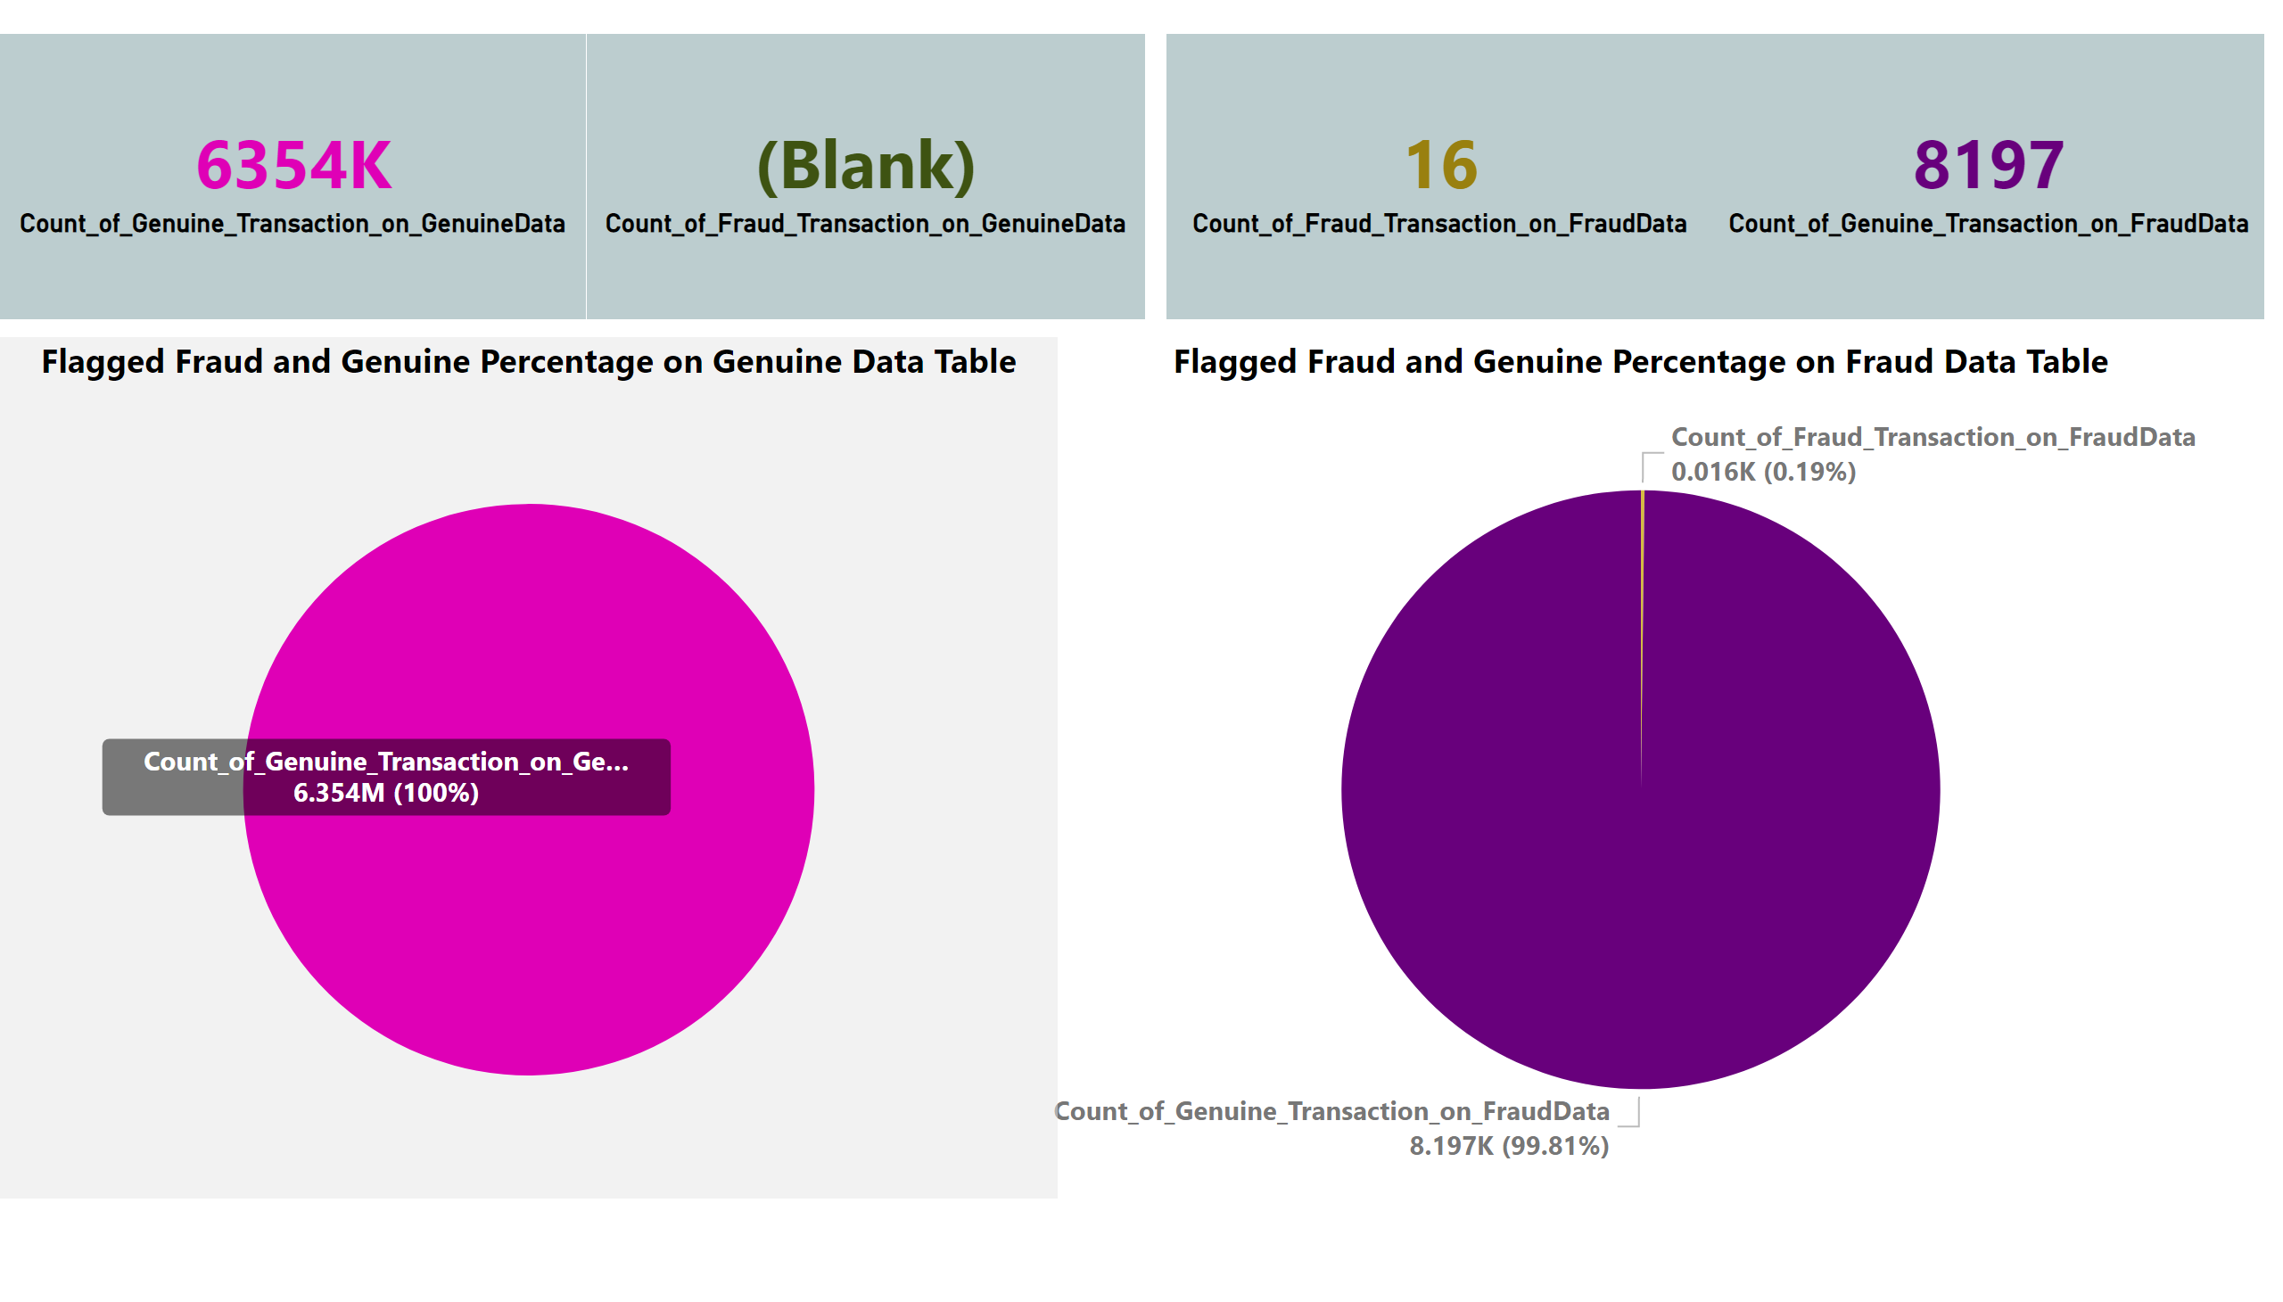
PAYMENT
FRAUD DETECTION
TABLE OF CONTENTS
APPROACH ON HOW TO USE THE DATA
ANALYSIS ON FRAUD DATA
Fraud Transactions
8213
While looking at the Data, we can see that we are having both Fraud and Genuine Transactions. So for finding out the right insights from the data we basically have to split the data according to the fraud and genuine transactions.
Flagged Genuine Transactions
8197
So, we will create two Data frames :
1. Fraud_data – Contains all the data of Fraud Transactions
2. Genuine_data – Contains all the data of Genuine Transactions
Flagged Fraud Transactions
16
ANALYSIS ON GENUINE DATA
Flagged Genuine Transactions %
99.81 %
INSIGHTS FROM DATA
Flagged Fraud Transactions %
0.19 %
OBSERVATIONS
After creating the Data frames we will find out the insights separately for fraud and genuine data
CONCLUSIONS
PREVENTIONS

Slide 8
PAYMENT
FRAUD DETECTION
TABLE OF CONTENTS
ANALYSIS ON FRAUD DATA
ANALYSIS ON GENUINE DATA
Genuine Transactions
6354407
Flagged Genuine Transactions
6354407
Flagged Fraud Transactions
0
Flagged Genuine Transactions %
100 %
INSIGHTS FROM DATA
Flagged Fraud Transactions %
0 %
OBSERVATIONS
CONCLUSIONS
PREVENTIONS

Slide 9
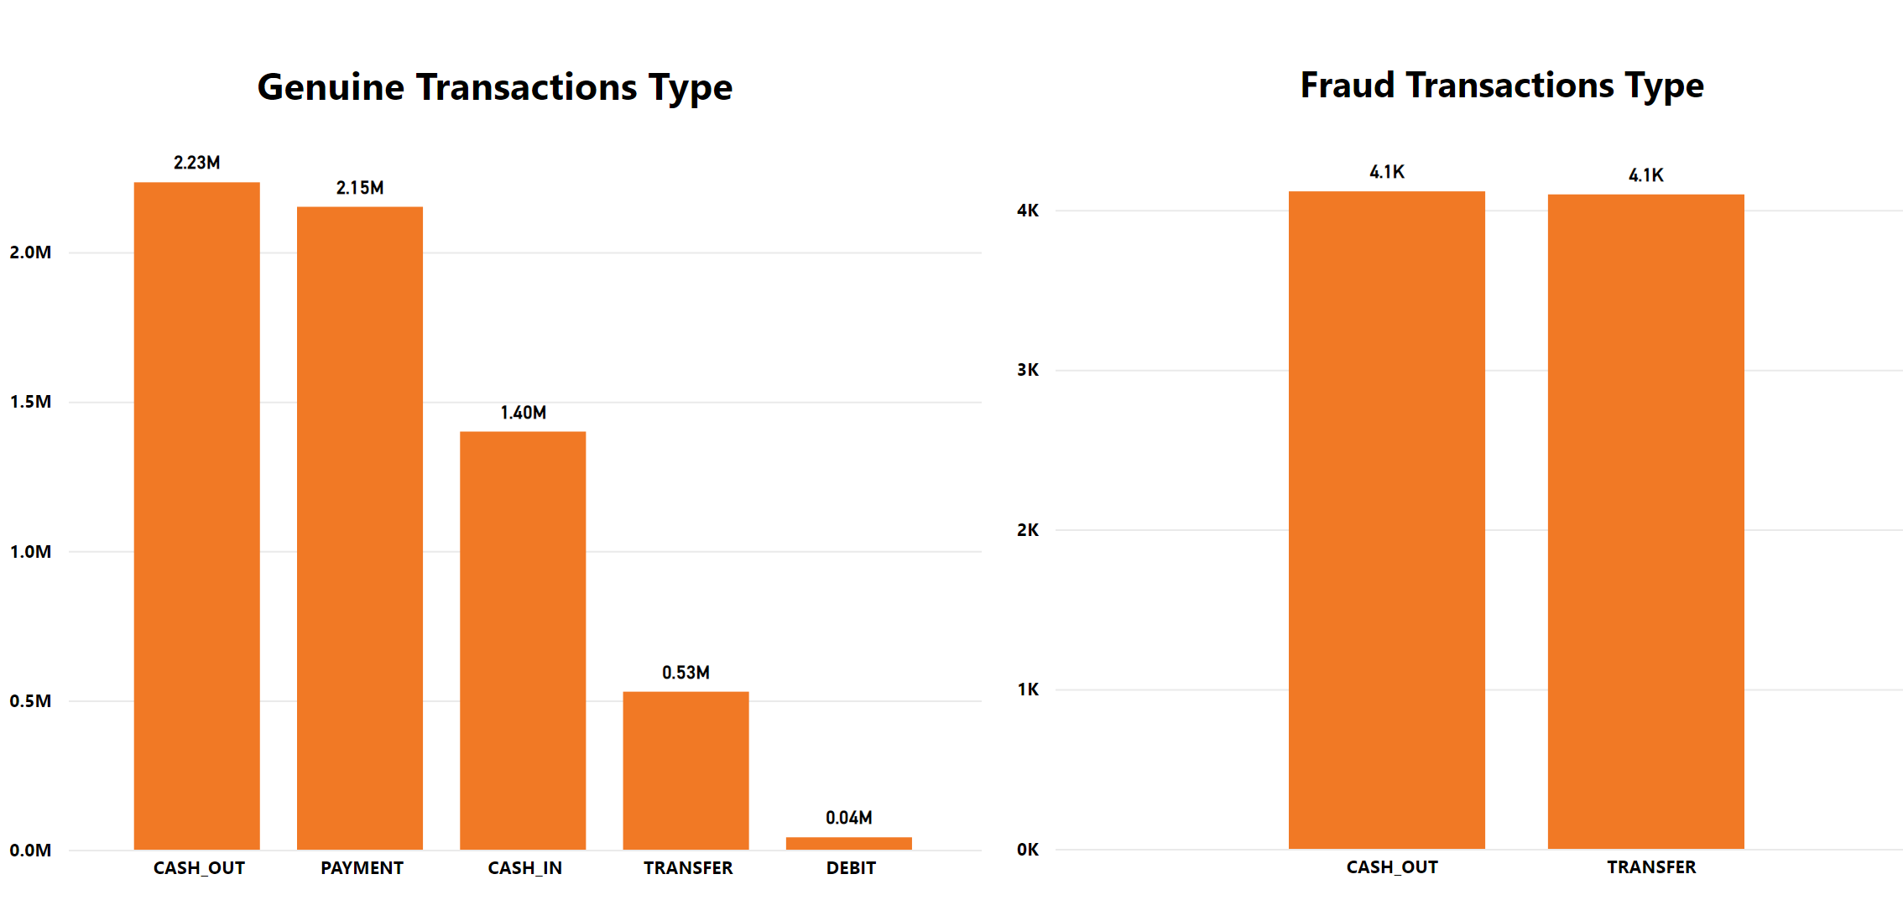
PAYMENT
FRAUD DETECTION
TABLE OF CONTENTS
ANALYSIS ON GENUINE DATA
INSIGHTS FROM DATA
OBSERVATIONS
CONCLUSIONS
PREVENTIONS

Slide 10
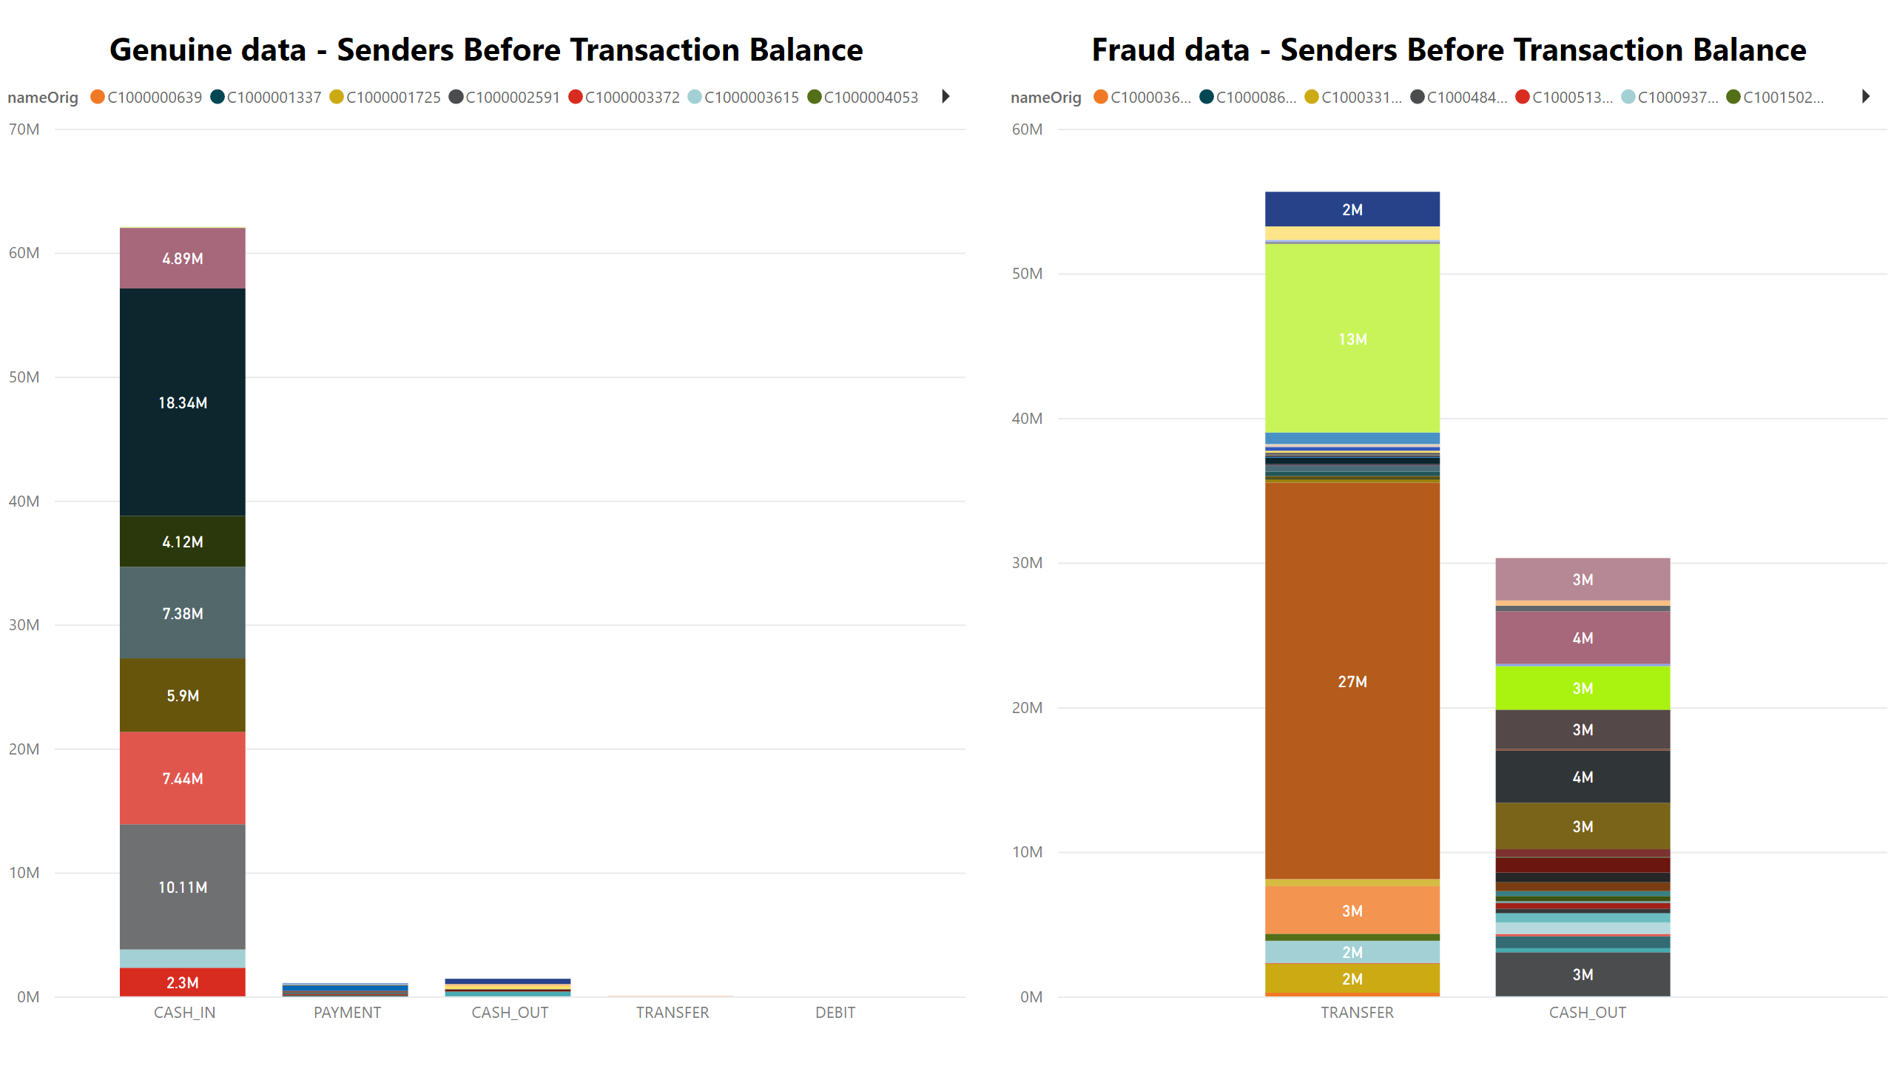
PAYMENT
FRAUD DETECTION
TABLE OF CONTENTS
ANALYSIS ON GENUINE DATA
INSIGHTS FROM DATA
OBSERVATIONS
CONCLUSIONS
PREVENTIONS

Slide 11
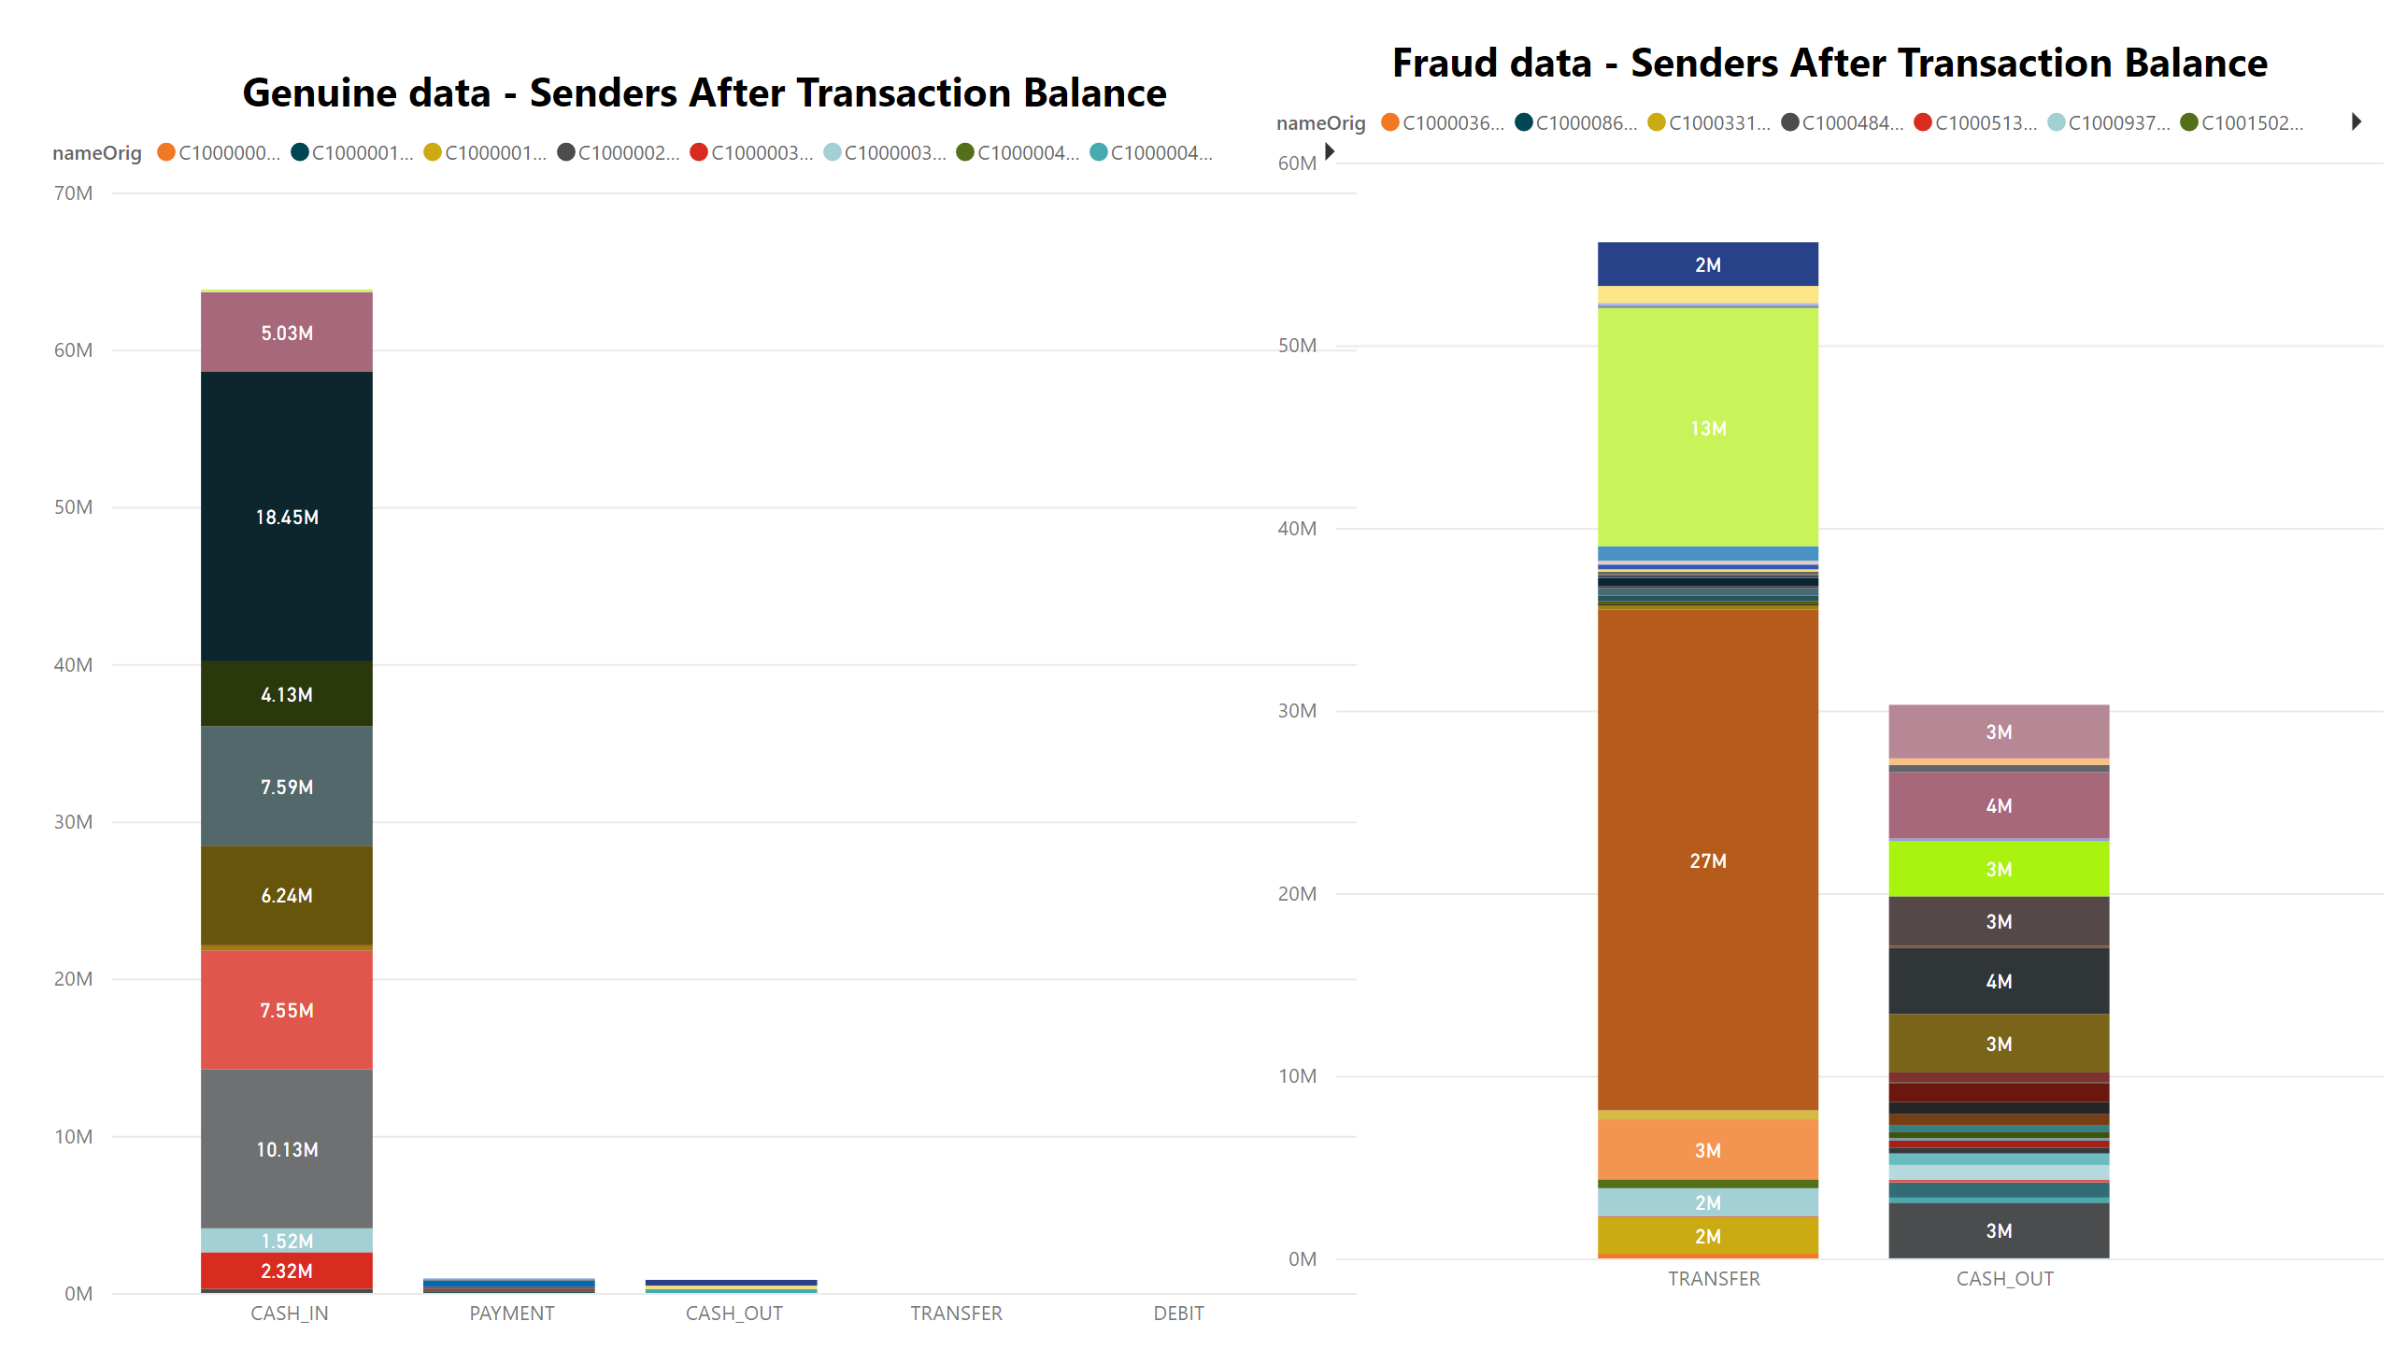
PAYMENT
FRAUD DETECTION
TABLE OF CONTENTS
ANALYSIS ON GENUINE DATA
INSIGHTS FROM DATA
OBSERVATIONS
CONCLUSIONS
PREVENTIONS

Slide 12
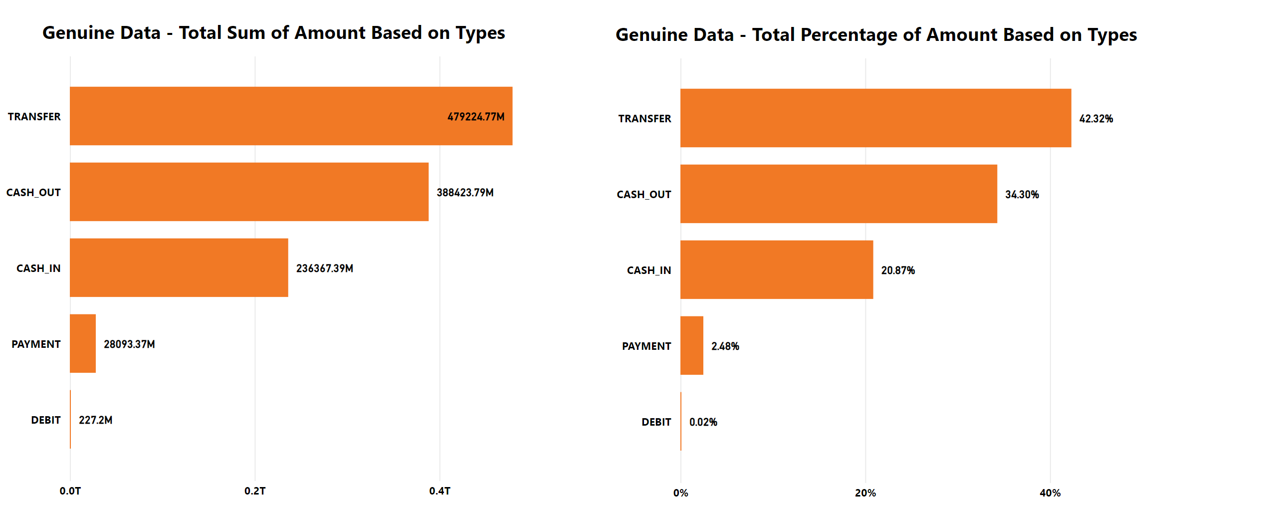
PAYMENT
FRAUD DETECTION
TABLE OF CONTENTS
ANALYSIS ON GENUINE DATA
INSIGHTS FROM DATA
OBSERVATIONS
CONCLUSIONS
PREVENTIONS

Slide 13
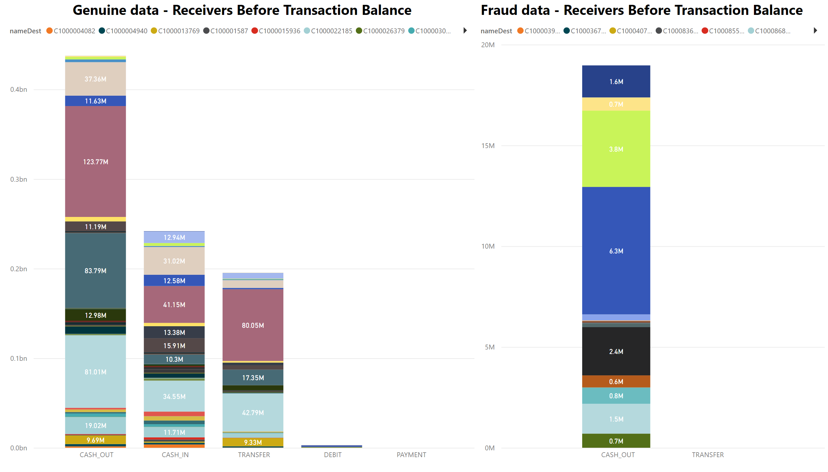
PAYMENT
FRAUD DETECTION
TABLE OF CONTENTS
ANALYSIS ON GENUINE DATA
INSIGHTS FROM DATA
OBSERVATIONS
CONCLUSIONS
PREVENTIONS

Slide 14
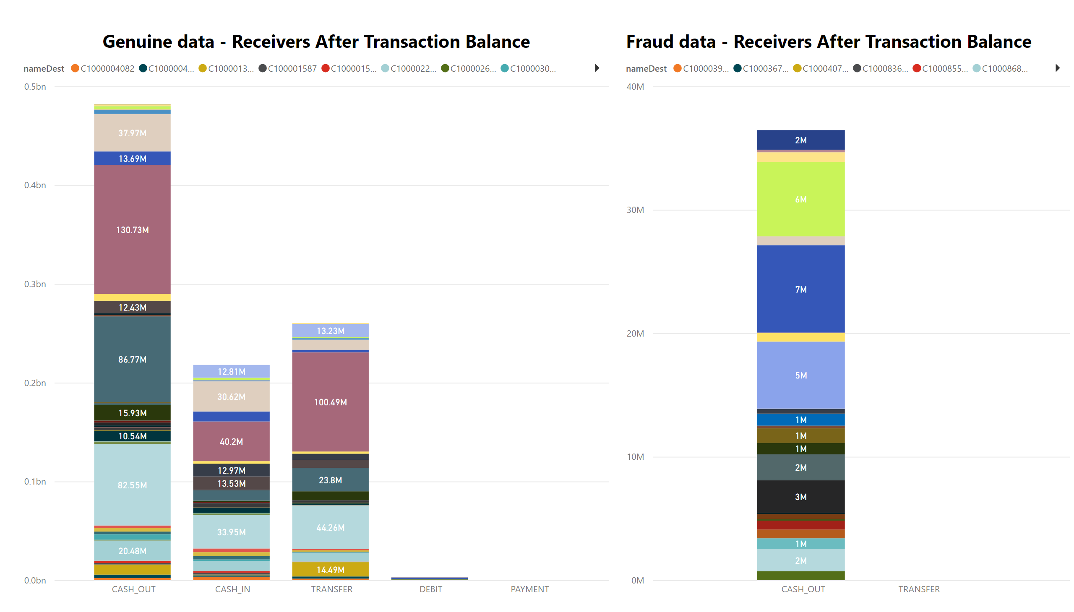
PAYMENT
FRAUD DETECTION
TABLE OF CONTENTS
ANALYSIS ON GENUINE DATA
INSIGHTS FROM DATA
OBSERVATIONS
CONCLUSIONS
PREVENTIONS

Slide 15
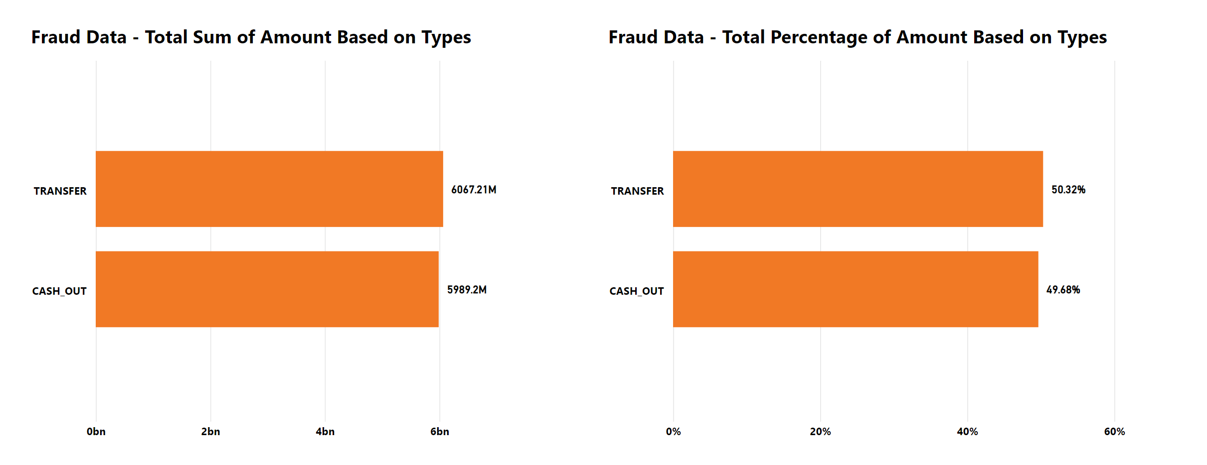
PAYMENT
FRAUD DETECTION
TABLE OF CONTENTS
ANALYSIS ON GENUINE DATA
INSIGHTS FROM DATA
OBSERVATIONS
CONCLUSIONS
PREVENTIONS

Slide 16
PAYMENT
FRAUD DETECTION
INSIGHTS FROM DATA
OBSERVATIONS
The provided dataset contains several columns that provide important information about financial transactions.
The "step" column represents the time elapsed since the beginning of the simulation and can be used to track the timing and sequence of transactions.
The "type" column indicates the type of transaction made, such as TRANSFER, CASH_OUT, CASH_IN, and PAYMENT.
The "amount" column represents the amount of money involved in each transaction, while the "name Orig" and "name dest" columns provide information about the account holders involved in the transaction.
The "old balance org" and "old balance dest" columns represent the account balances of the account holders prior to the transaction, while the "new balance orig" and "new balance dest" columns represent their account balances after the transaction.
The "is fraud" and "is flagged fraud" columns are useful for identifying potentially fraudulent activity in the dataset, with the former indicating whether a transaction was marked as fraudulent and the latter indicating whether the system flagged the transaction as potentially fraudulent.
Overall, these columns provide a wealth of information that can be used to analyze transaction patterns, track individual account holders, and identify potential fraud.
CONCLUSIONS
PREVENTIONS

Slide 17
OBSERVATIONS
The provided dataset contains several columns that provide important information about financial transactions.
The "step" column represents the time elapsed since the beginning of the simulation and can be used to track the timing and sequence of transactions.
The "type" column indicates the type of transaction made, such as TRANSFER, CASH_OUT, CASH_IN, and PAYMENT.
The "amount" column represents the amount of money involved in each transaction, while the "name Orig" and "name dest" columns provide information about the account holders involved in the transaction.
The "old balance org" and "old balance dest" columns represent the account balances of the account holders prior to the transaction, while the "new balance orig" and "new balance dest" columns represent their account balances after the transaction.
The "is fraud" and "is flagged fraud" columns are useful for identifying potentially fraudulent activity in the dataset, with the former indicating whether a transaction was marked as fraudulent and the latter indicating whether the system flagged the transaction as potentially fraudulent.
Overall, these columns provide a wealth of information that can be used to analyze transaction patterns, track individual account holders, and identify potential fraud.
PAYMENT
FRAUD DETECTION
CONCLUSIONS
In conclusion, the columns step, type, amount, name Orig, old balance org, new balance orig, name dest, old balance dest, new balance dest, is fraud, and is flagged fraud provide valuable insights into financial transactions and fraud detection. These columns appear to represent important information related to the order, type, and amount of transactions, as well as the names and account balances of the parties involved.
Furthermore, the inclusion of columns such as "is fraud" and "is flagged fraud" suggests that the dataset is specifically focused on identifying and detecting fraudulent transactions. These columns likely play a crucial role in developing fraud detection models and systems.
Overall, the analysis of these columns provides a foundation for developing a deeper understanding of financial transactions and the detection of fraudulent activities. Further exploration and analysis of the data set may reveal additional insights and patterns that can be used to improve fraud detection methods and protect financial institutions and their customers.
PREVENTIONS

Slide 18
OBSERVATIONS
The "is fraud" and "is flagged fraud" columns are useful for identifying potentially fraudulent activity in the dataset, with the former indicating whether a transaction was marked as fraudulent and the latter indicating whether the system flagged the transaction as potentially fraudulent.
Overall, these columns provide a wealth of information that can be used to analyze transaction patterns, track individual account holders, and identify potential fraud.
PAYMENT
FRAUD DETECTION
CONCLUSIONS
PREVENTIONS
In conclusion, the columns step, type, amount, name Orig, old balance org, new balance orig, name dest, old balance dest, new balance dest, is fraud, and is flagged fraud provide valuable insights into financial transactions and fraud detection. These columns appear to represent important information related to the order, type, and amount of transactions, as well as the names and account balances of the parties involved.
Furthermore, the inclusion of columns such as "is fraud" and "is flagged fraud" suggests that the dataset is specifically focused on identifying and detecting fraudulent transactions. These columns likely play a crucial role in developing fraud detection models and systems.
Overall, the analysis of these columns provides a foundation for developing a deeper understanding of financial transactions and the detection of fraudulent activities. Further exploration and analysis of the data set may reveal additional insights and patterns that can be used to improve fraud detection methods and protect financial institutions and their customers.
Social media lookup : We can see if the cardholder’s details match those of the online social profile. It helps extract extra info such as a profile picture, full name, bio, etc.
IP analysis : Beyond checking geolocation, you can also tell if your user is hiding their connection behind a VPN, proxy or emulator.
Email analysis : Even a single data point such as a phone number or email address can reveal a trove of data. Was it created from a suspicious domain (free or disposable address)? How hard was the authentication process? Has it appeared on any data breaches?
Phone analysis : Likewise, a phone number can be checked against a records to get a clearer idea of who you’re dealing with. Is it a landline or mobile? Is the carrier location close to the shipping address? Is your user relying on a disposable phone number?

Slide 19
OBSERVATIONS
The "is fraud" and "is flagged fraud" columns are useful for identifying potentially fraudulent activity in the dataset, with the former indicating whether a transaction was marked as fraudulent and the latter indicating whether the system flagged the transaction as potentially fraudulent.
Overall, these columns provide a wealth of information that can be used to analyze transaction patterns, track individual account holders, and identify potential fraud.
PAYMENT
FRAUD DETECTION
PREVENTIONS
CONCLUSIONS
Social media lookup : We can see if the cardholder’s details match those of the online social profile. It helps extract extra info such as a profile picture, full name, bio, etc.
IP analysis : Beyond checking geolocation, you can also tell if your user is hiding their connection behind a VPN, proxy or emulator.
Email analysis : Even a single data point such as a phone number or email address can reveal a trove of data. Was it created from a suspicious domain (free or disposable address)? How hard was the authentication process? Has it appeared on any data breaches? Find out more about reverse email search lookup modules.
Phone analysis : Likewise, a phone number can be checked against a records to get a clearer idea of who you’re dealing with. Is it a landline or mobile? Is the carrier location close to the shipping address? Is your user relying on a disposable phone number?
THANKYOU
THANKYOU

